Slide 1
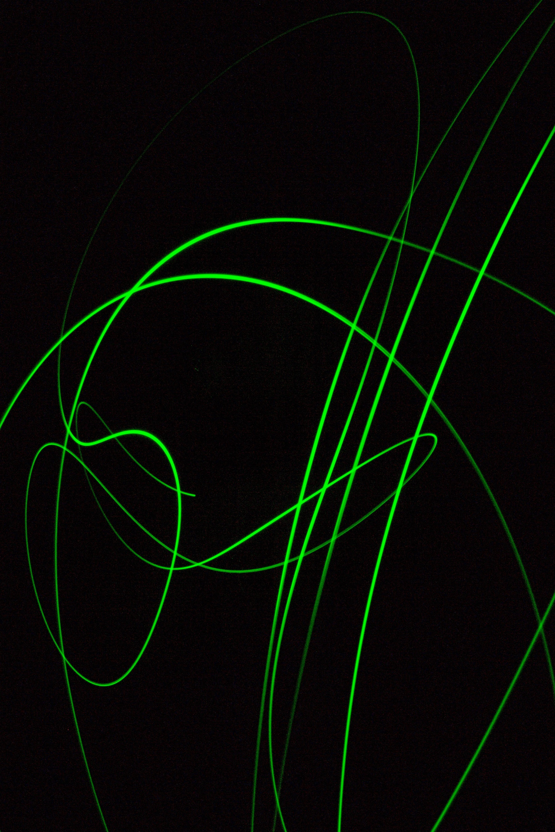
Remote and language-agnostic API using gRPC and NI LabVIEW
Nikita Prorekhin, CLA
Senior Software Engineer at NOFFZ Technologies GmbH

Slide 2
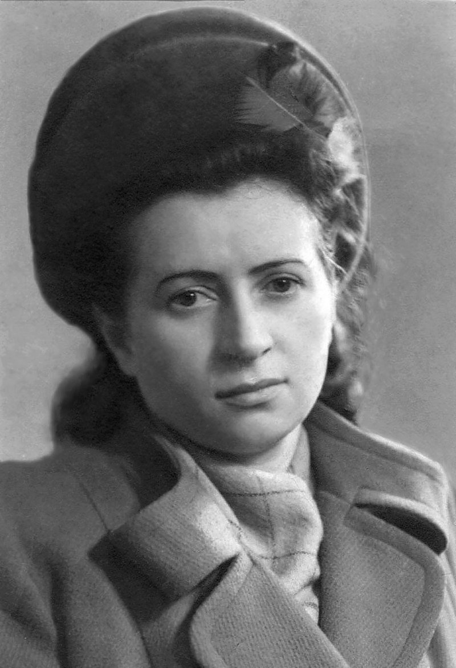
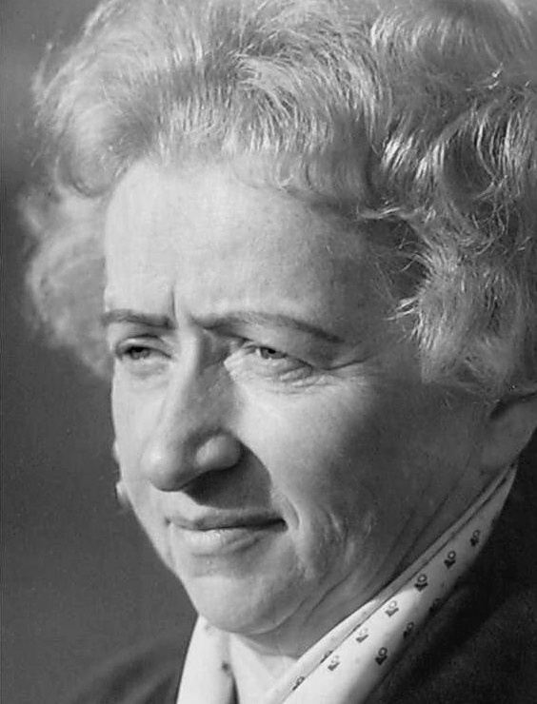
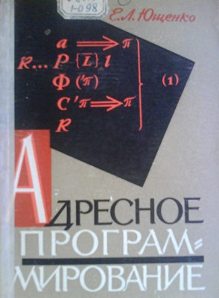
#ourgiantsarefemale
Kateryna Yushchenko (1919 – 2001)
Yushchenko was a Ukrainian computer and information research scientist
She was the first woman in the USSR to become a Doctor of Physical and Mathematical Sciences in programming.
Yushchenko developed one of the world's first high-level languages called the Address programming language
The language became the means of manipulation of the second-rank addresses (Pointers) and higher ranks.
Yushchenko was the founder of the first Soviet School of Theoretical Programming

Slide 3
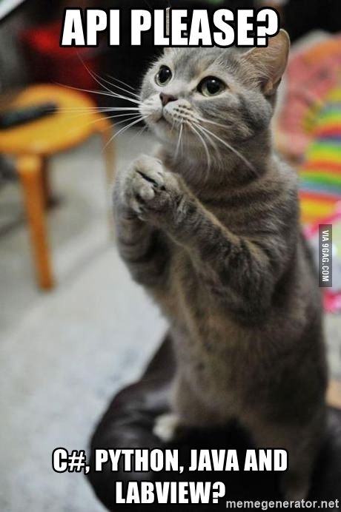
Problem statement
Our favourite customer asks us to build…
Remote API for software written in LabVIEW
Want to call functions and stream data
Compatible with C#, Python, Java and LabVIEW
It should be extensible in the future
Probably we also need C++ and Web support

Slide 4
Wow! Let’s try… gRPC!
gRPC!

Slide 5
What is gRPC?
gRPC is…
Popular open source RPC framework
Cross-platform
Supports 11 major programming languages
Contract first
Uses modern technology
HTTP/2
Protobuf
+
=
Source: https://youtu.be/CXH_jEa8dUw

Slide 6
What is gRPC?
gRPC is…
Enables multiplexing, advanced streaming
High-performance. Protobuf is small and fast
HTTP/2 isn’t supported everywhere
Probobuf isn’t human readable
gRPC Client
Client
gRPC Server
gRPC Clients
Request
Response
Generate client
.proto file
Generate service base
.proto file + gRPC tooling for selected language/platform
Productivity. Automatic code generation
Contract & tooling is required
Source: https://youtu.be/CXH_jEa8dUw

Slide 7
What is gRPC?
Protocol Buffers and .proto files
.proto file is a text file with its own syntax
Defines the contract
.proto file is used to auto generate code
Protocol Buffers are responsible for serializing and deserializing data
syntax = "proto3";
service TemperatureService{
rpc Measure (Units) returns (Temperature);
}
message Units {
int32 unit = 1;
}
message Temperature {
double temperature = 1;
}

Slide 8
What is gRPC?
Types of RPC supported
1 request - 1 response
1 request - N responses (Server streaming)
N requests - 1 response (Client streaming)
N requests - N responses (Bi-directional streaming)
Notes:
This is more than enough for LabVIEW

Slide 9
Is gRPC relevant to NI LabVIEW?
Yes! Remote API is an important element of our work
We often create client-server apps
And therefore we create communication protocols
TCP/IP or UDP, or NI STM, or Actor Network Endpoints or…
And we maintain the protocols
Documentation, tests, updates
And we support different programming languages
Sadly, there are software teams that don’t work with LabVIEW

Slide 10
OK. Is gRPC available in LabVIEW?
Notes:
To answer this question let’s take a look a the key facts

Slide 11

gRPC in LabVIEW
Walkthrough on creating a Server and a Client

Slide 12
gRPC in LabVIEW
Tools available in November 2021
https://github.com/ni/grpc-labview
Open source, MIT License
Not yet completed, under development
Release 0.4.0 is available
ni_lib_labview_grpc_library-0.4.0.1.vip
ni_lib_grpc_server_and_client_template-0.4.0.1.vip
Don’t miss the presentation from the maintainer - Christopher Cifra at 6 p.m. (Europe time) today!
There is also gRPC Device project from NI!

Slide 13
gRPC in LabVIEW
Let’s build an app!
Ex 1 - Remote Temperature Measurement device
Get Temperature by command
Request Temperature in Celsius or Fahrenheit
DEMO

Slide 14
gRPC in LabVIEW
Let’s build an app!
Ex 2 - Remote Temperature Controller device
Enable or disable temperature controller
Setpoint in Celsius or Fahrenheit
Measure temperature
Client in LabVIEW
Client in C# and .NET Core
DEMO

Slide 15
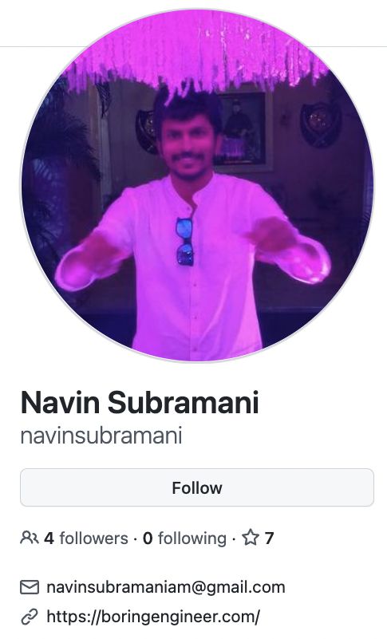
gRPC in LabVIEW
Let’s build an app!
Ex 3 - Noise Waveform and PS Density by Navin Subramani
Generate signals by command
Change signal parameters
Measure signal parameters
Client in LabVIEW
Client in Python
DEMO

Slide 16
gRPC in LabVIEW
Let’s build an app!
Ex 4 - Audio Signal Streamer
Stream multiple channels at 48 kHz
Server streaming RPC
DEMO

Slide 17
Where to go next?
Presentation gRPC and LabVIEW by Christopher Cifra (NI) today
There will be a lot of useful information!
https://grpc.io
https://github.com/ni/grpc-labview
https://github.com/grpc-ecosystem/awesome-grpc
Enjoy GLA Summit 2021!

